Slide 1
Thermal Conductivity
Dan Marrinan
Sam Stuard

Slide 2
Overview
Introduce effects of temperature gradients on metals and explain thermocouples
Show the heat equation and its solution with the given boundary conditions
Demonstrate the experimental setup and procedure
Present results
Discuss interpretation of results

Slide 3
Introduction
Heat conduction takes place all around us
Heat exchangers in power generation
HVAC
Computers

Slide 4


Metal with Temperature Gradient
T_{H}
Electrical current density in metal with temperature gradient
“Hot” electrons diffuse faster than “cold” electrons
Electron concentration gradient forms electric field
T_{L}

Slide 5

Thermocouples
Metals have different Seebeck Coefficients
Cold junction compensation
T_{H}
Metal 1
T_{L}
T_{H}
Metal 1
Metal 2
Metal 2
Metal 2
A
B
A
B

Slide 6

Heat Transfer
Heat transferred by electrons and phonons
Diffusion of electrons
Vibrations in crystal lattice form packets of energy called phonons
Fourier’s Law

Slide 7


Heat Equation
y
x
x + Δx
x
Apply conservation of energy
Boundary conditions: U(0,t) = U(L,t) = 0
Initial Condition: U(x,0) = kx
Purpose of this experiment was to test U(x,t)
A

Slide 8
Experimental Setup
Cold Water Input
Cold Water Input
To PC
DAQ
Valve
T_{H}
T_{C}
Valve
Hot Water Output
Cold Water Output

Slide 9
Experimental Procedure
Turn on DAQ
Turn on cold water
Trap hot water
Let system reach steady state
Let cold water flow through both sides
Wait!

Slide 10
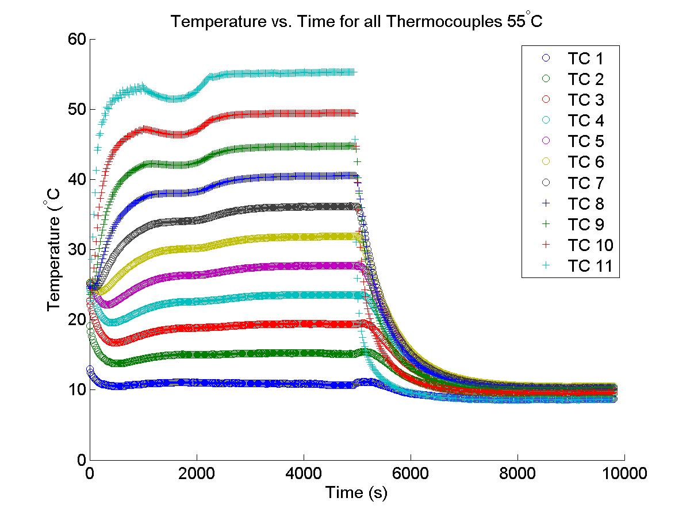

Slide 11
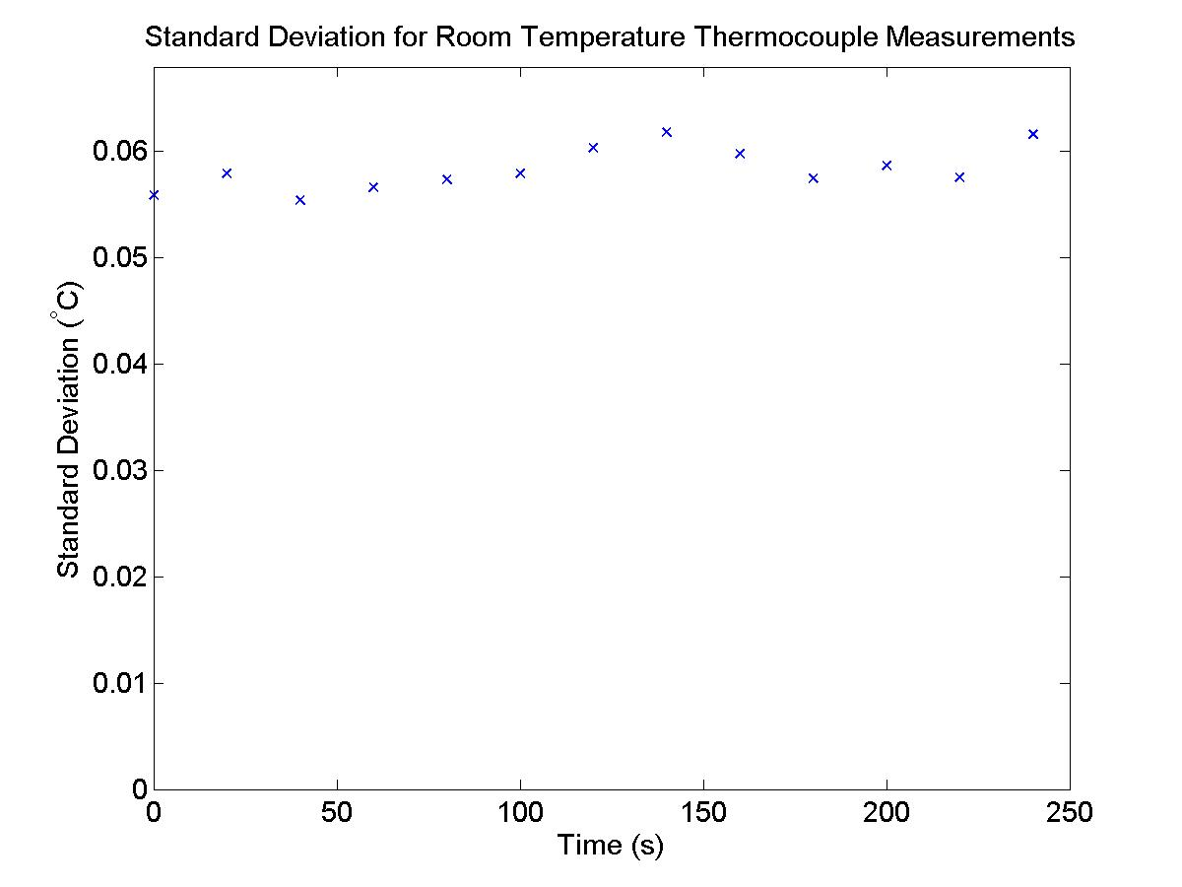

Slide 12
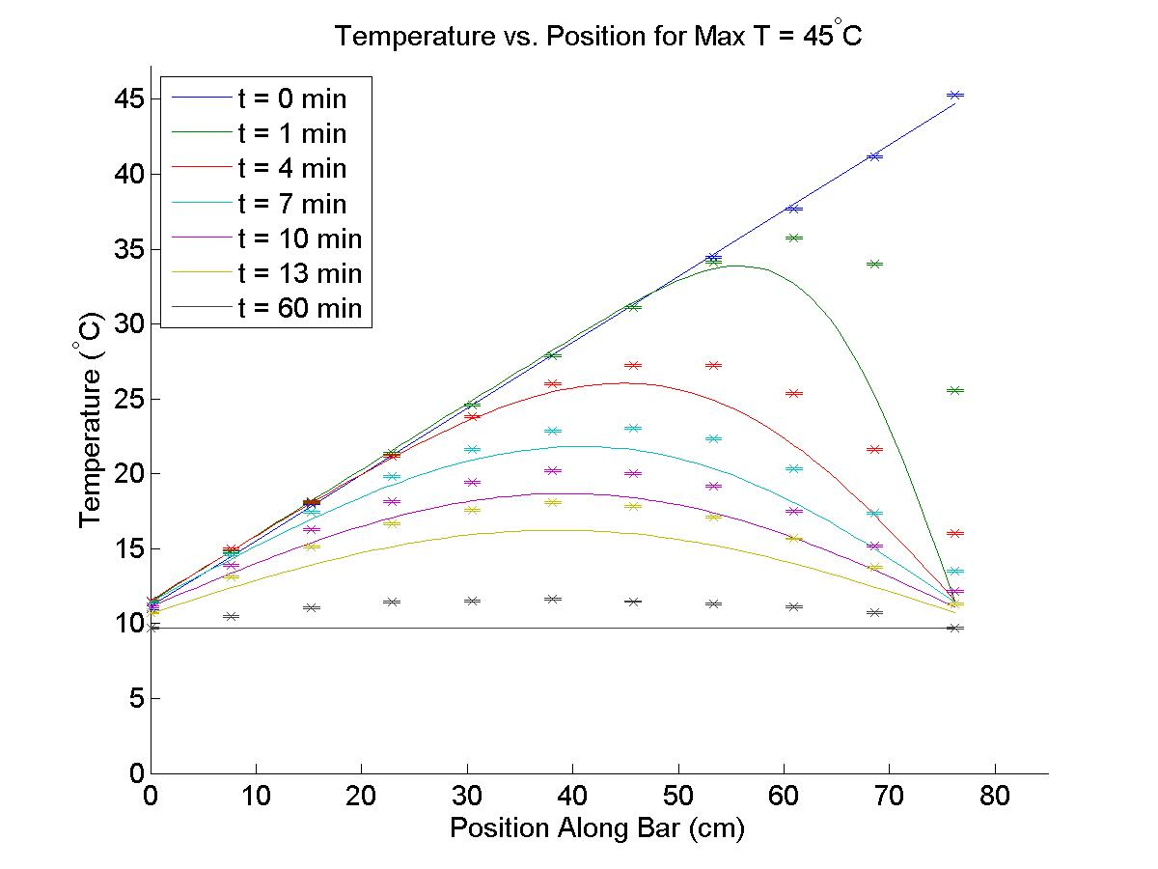
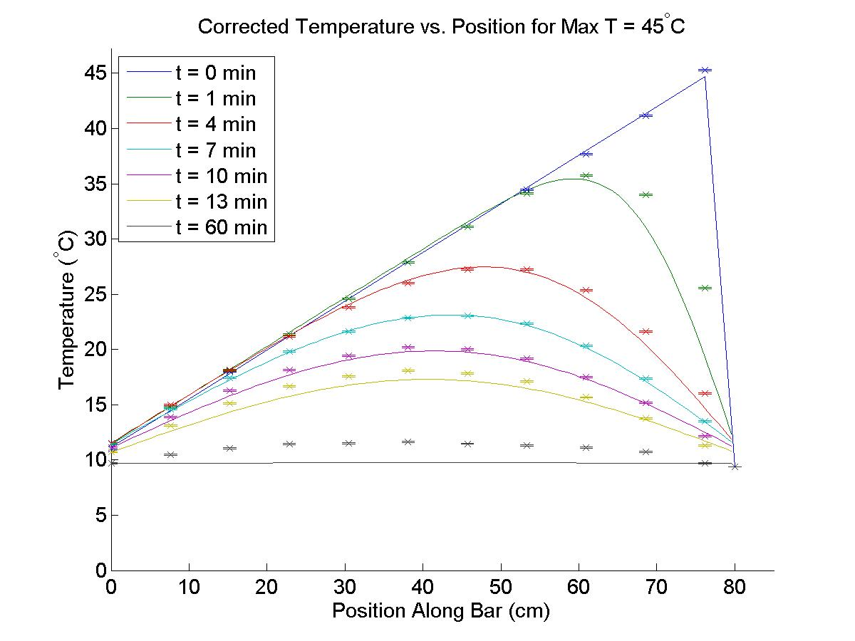

Slide 13
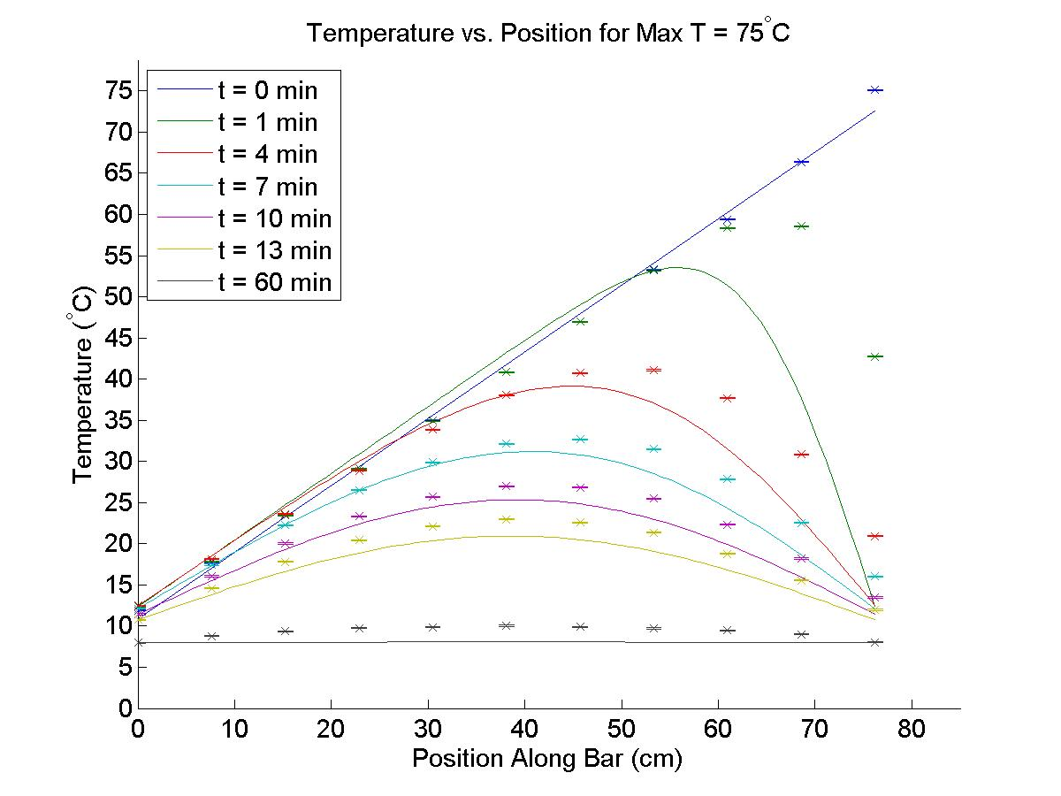
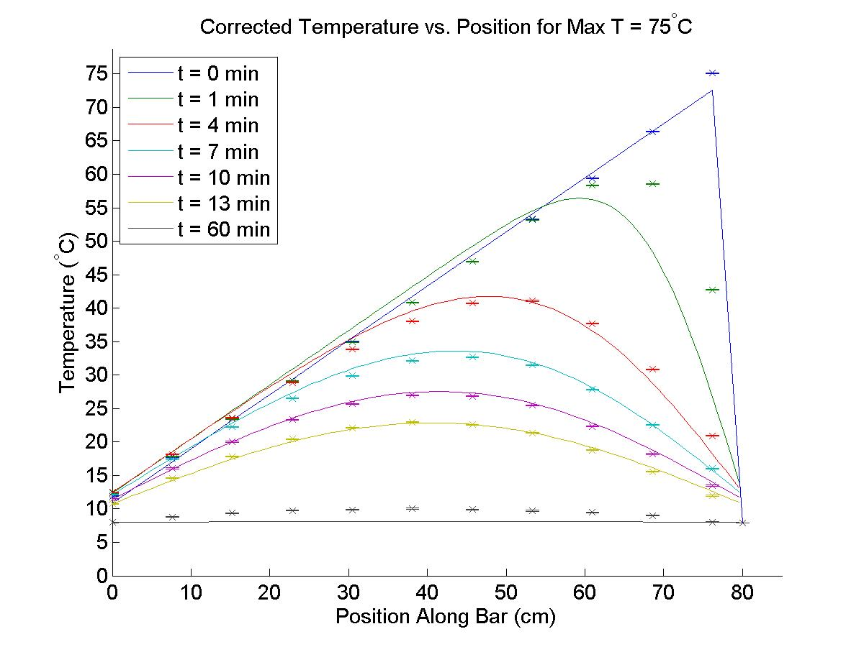

Slide 14
Corrections to Experimental Data
Added 1.5” piece of copper after “hot” thermocouple
Estimate heat transfer due to radial conduction
Estimate heat transfer due to radiation
Explains nonlinearity at t=0
Explains why theory and data don’t converge for large times
 | 45° C | 50° C | 55° C | 75° C
Original χ² for t = 1 min | 20.7 | 8.7 | 46.7 | 87.7
Corrected χ² for t = 1 min | 2.3 | 0.1 | 6.8 | 12.4

Slide 15
Conclusions
Solution to heat equation was good but incomplete
Including other methods of heat transfer give a better solution, but also make differential equation more difficult to solve.

